Slide 1
MOVIES RECOMENDATION SYSTEM
Here is where your presentations begins

Slide 2
TABLE OF CONTENTS
01
Introduction
Evaluation & Comparison
02
Dataset Overview
03
Cleaning & Feature Engineering
05
04
Streamlit Dashboard
Models
01
06
02
07
Deployment
03
04
05

Slide 3
01
INTRODUCTION
01

Slide 4
“ Personalized recommendation systems have become vital in industries like movies, music, and e-commerce, enhancing user experiences by offering tailored suggestions. This project focuses on the MovieLens 30M dataset, a benchmark for evaluating recommendation algorithms. “

Slide 5

The goal is to analyze, clean, and preprocess the data, then develop three advanced models: Content-Based Filtering, Neural Collaborative Filtering (NCF), and Hybrid Recommendation. These models aim to improve recommendation accuracy and performance.
Additionally, the project includes evaluating the models' effectiveness and visualizing key insights to understand their strengths and weaknesses.

Slide 6
DATA OVERVIEW
02

Slide 7
KEY COLUMNS
userId: Identifier of the user who provided the rating
movieId: Identifier of the rated
rating: Rating score (ranging from 0.5 to 5.0)
genres: Genres associated with the movies
timestamp: Time the rating was given (in UNIX epoch format)

Slide 8


ratings_df
movies_df
Missing values: None
Duplicate entries: None
Unique users: 330,975
Unique rated movies: 83,239
Timestamp conversion: Successfully converted using pd.to_datetime
Total movies: 86,537
Movies with no ratings in ratings_df: 3,298
Most frequent title: "Alone" (2020)
Most common genre: Drama (12,246 movies)
Unique genres: 1,796
Unique titles: 86,330 (with 207 duplicates)

Slide 9
DATA CLEANING & FEATURE ENGINEERING
03

Slide 10
WHAT I DO
User & Movie Stats
Calculated total ratings and average ratings per user and per movie.
Movies Processing
Extracted release year, one-hot encoded genres, and merged average ratings.
Ratings Preparation
Merged with user stats, converted timestamps, and exported cleaned data.

Slide 11
WHAT I DO
Tags Processing
Combined tags per movie, applied TF-IDF vectorization, and merged results.
Sampling
Selected 1 million random ratings to reduce computation and ensure fast testing.
Final Movie Table
Unified all data, removed duplicates/missing IDs, cleaned column names.

Slide 12
WHAT I DO
Missing Values & Normalization:
Filled missing years using OMDb API, normalized features, and ensured type consistency.

Slide 13
STREAMLIT DASHBOARD
04
Exploratory data analysis

Slide 14
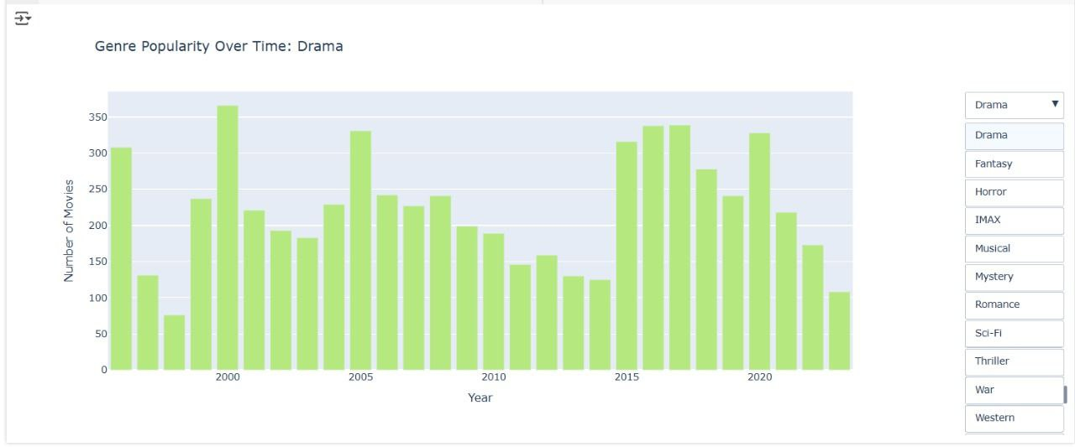
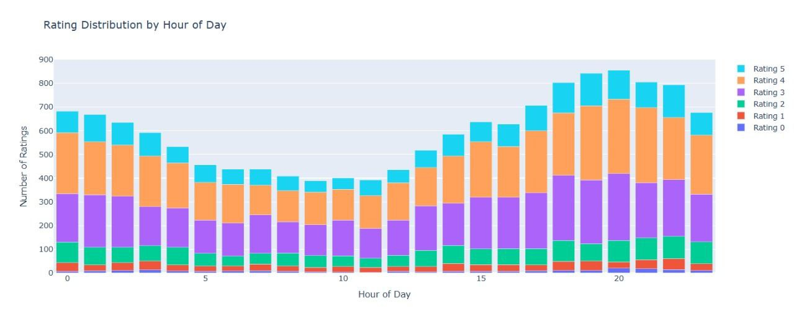

Slide 15
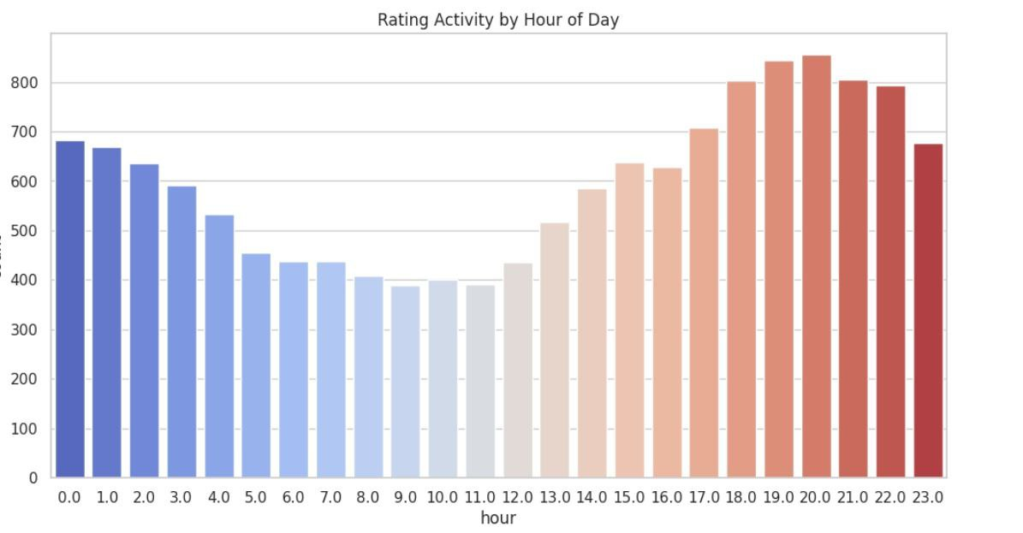
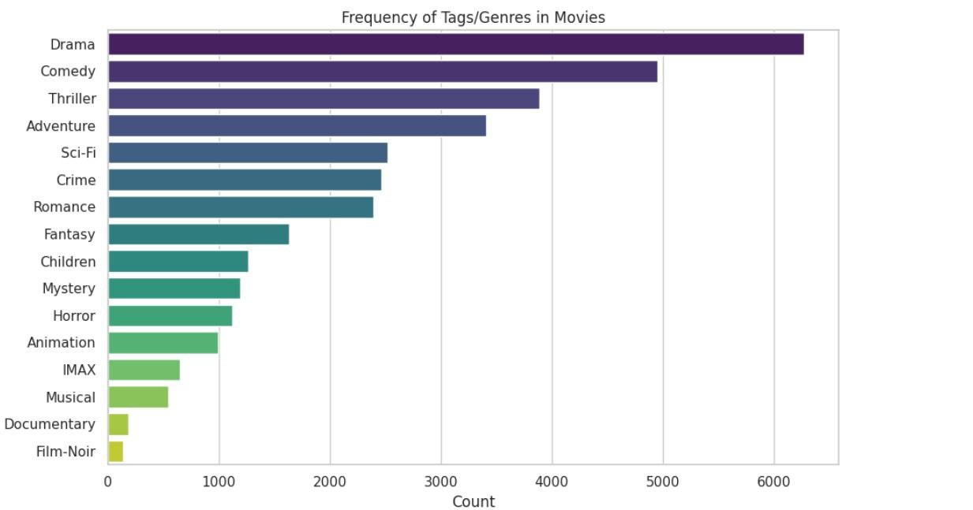

Slide 16
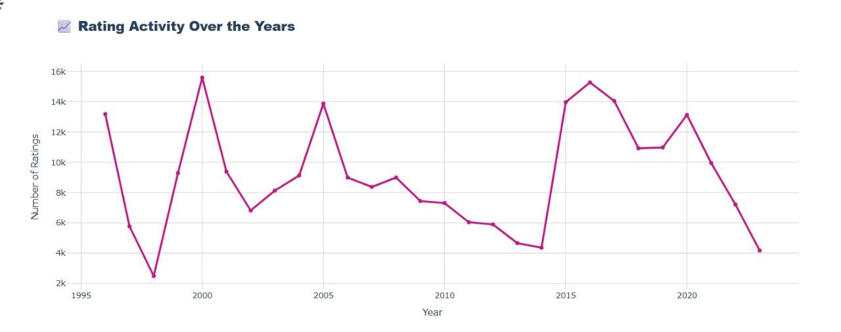

Slide 17
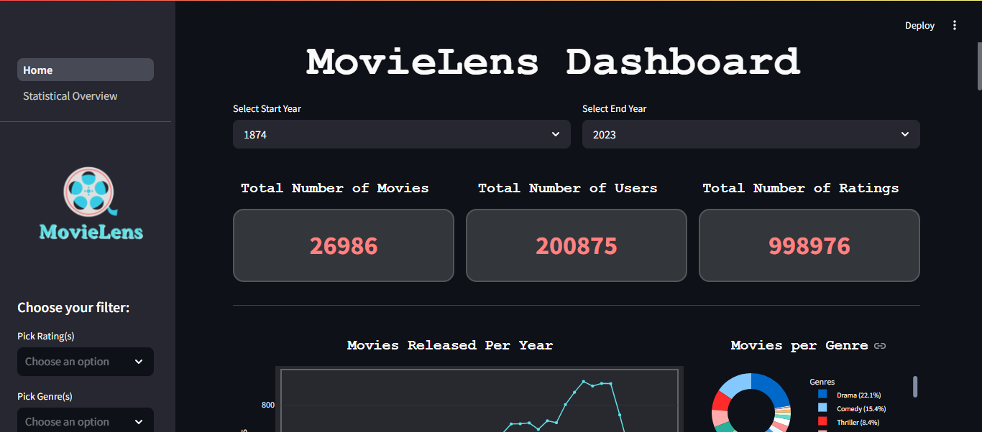
Sample of The dashboard components:
Filter Options:
Filters for movie genre, release year, and user rating

Slide 18
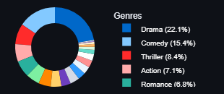
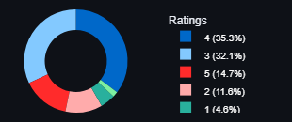

Genre Distribution
Top genres: Drama, Comedy, Thriller.
Drama dominates, making up over 20% of movies.
Rating Distribution
Most ratings are 4 stars, followed by 3.
Shows a positive bias in user ratings.

Slide 19
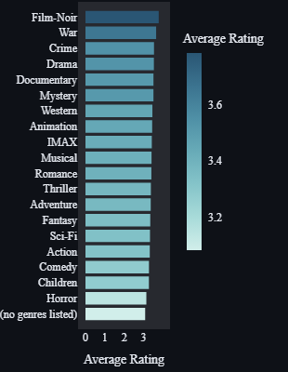
Genre Ratings
Best-rated genres: Film-Noir, War, Crime.
Lower-rated: Horror, Children, Comedy.

Slide 20
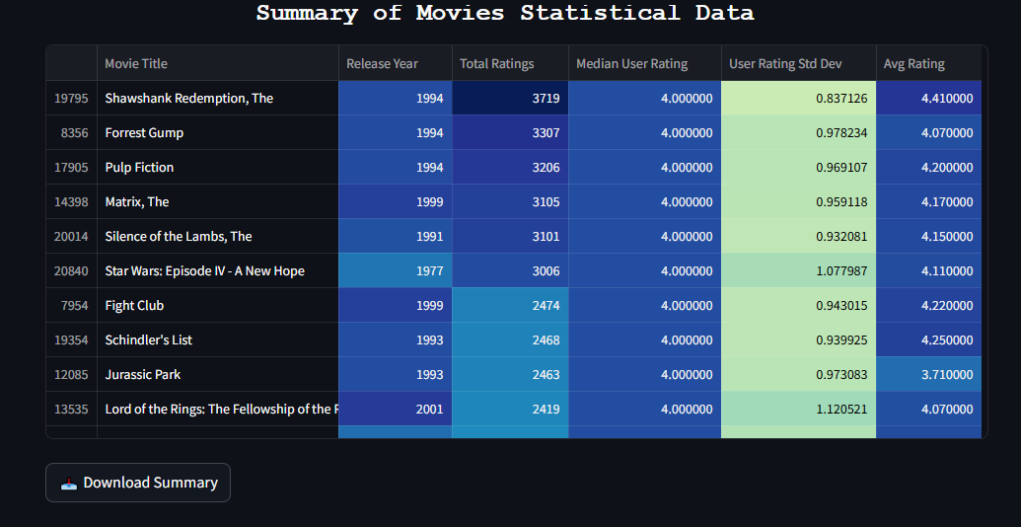
Statistical Summary Table
Includes total ratings, average, median, and standard deviation per movie.
Download Option: Allows users to export summary data in CSV format.

Slide 21
ML MODELS
05

Slide 22
1
2
3
Content-Based Recommendation Model
We implemented three distinct recommendation models to generate personalized movie suggestions:
Neural Collaborative Filtering
Model
Hybrid Recommendation Model
Each model was built with a unique pipeline and learning strategy.

Slide 23

Content-Based Recommendation Model
Goal :
Key Highlights:
Recommend movies similar to those a user liked, based on content attributes (genres, year, titles).
Data Preprocessing : Handled missing values, one-hot encoded genres, and applied TF-IDF on titles.
Feature Engineering : Built rich user/movie features (rating stats, genre vectors, TF-IDF vectors, etc.).

Slide 24
Content-Based Recommendation Model
Goal :
Key Highlights:
Recommend movies similar to those a user liked, based on content attributes (genres, year, titles).
Model Architecture:
Feed-forward neural network using TensorFlow & Keras.
Loss: Mean Squared Error (MSE).
Performance:
RMSE (Train/Test): 0.744 / 0.859
MAE (Train/Test): 0.563 / 0.643
Low Precision@K & Recall@K

Slide 25

Neural Collaborative Filtering (NCF) Model
Goal :
Key Highlights:
Recommend movies by learning user–item interactions from the rating matrix, without using movie content.
Data Preparation : Used userId, movieId, rating with normalization (MinMaxScaler).
Model Architecture :
Built with TensorFlow Recommenders (TFRS).
Includes user/item embeddings + MLP + regression output.

Slide 26
Neural Collaborative Filtering (NCF) Model
Goal :
Key Highlights:
Recommend movies by learning user–item interactions from the rating matrix, without using movie content.
Training :
Loss: MSE, Optimizer: Adam
Early stopping and LR reduction applied.
Performance :
RMSE: 1.0629
Precision: 0.8723
F1-Score: 0.8444
MAE: 0.8321
Recall: 0.8189
NDCG: 0.8963

Slide 27
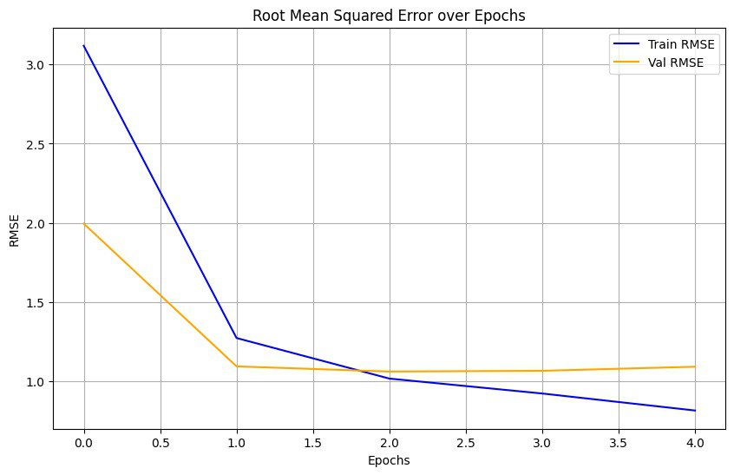
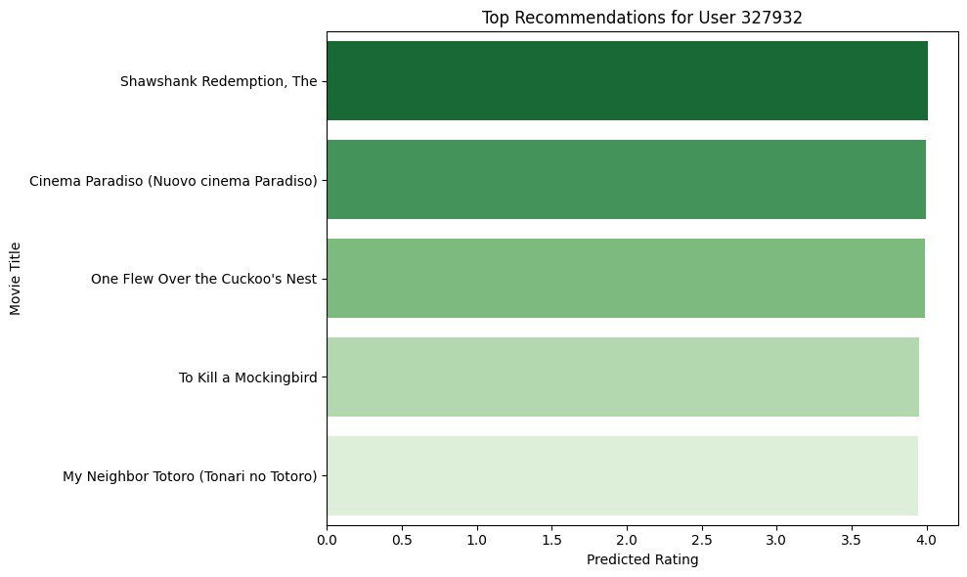
Neural Collaborative Filtering (NCF) Model

Slide 28

Hybrid Recommendation Model
Goal :
Key Highlights:
Combine strengths of both content-based and collaborative filtering for improved accuracy and personalization.
Data Integration :
Merged predictions from both previous models.
Filled missing values in interaction matrix.
Feature Engineering :
Used predicted scores + metadata as input features (standardized).

Slide 29
Hybrid Recommendation Model
Goal :
Key Highlights:
Combine strengths of both content-based and collaborative filtering for improved accuracy and personalization.
Model Architecture :
Simple feed-forward neural network:
Inputs: Combined predictions.
Dense layers capture feature interactions.
Output: Predicted rating.
Loss: MSE, Optimizer: Adam.

Slide 30
Hybrid Recommendation Model
Goal :
Key Highlights:
Combine strengths of both content-based and collaborative filtering for improved accuracy and personalization.
Performance :
RMSE: 0.9287
Precision: 0.8881
F1-Score: 0.7310
MAE: 0.7170
Recall: 0.6211
NDCG: 0.9893

Slide 31
Evaluation & Comparison
06

Slide 32

MODEL COMPARISON SUMMARY
 | Content-Based | NCF | Hybrid
RMSE | 0.859 | 1.0629 | 0.9287
MAE | 0.643 | 0.8321 | 0.7170
Precision | Low (Top-K) | 0.8723 | 0.8881
Recall | Low (Top-K) | 0.8189 | 0.6211
F1-Score | — | 0.8444 | 0.7310
NDCG | — | 0.8963 | 0.9893
Insight:
The Hybrid Model balances precision and content-awareness, achieving the highest NDCG for ranking quality and outperforming individual models in overall recommendation effectiveness.

Slide 33
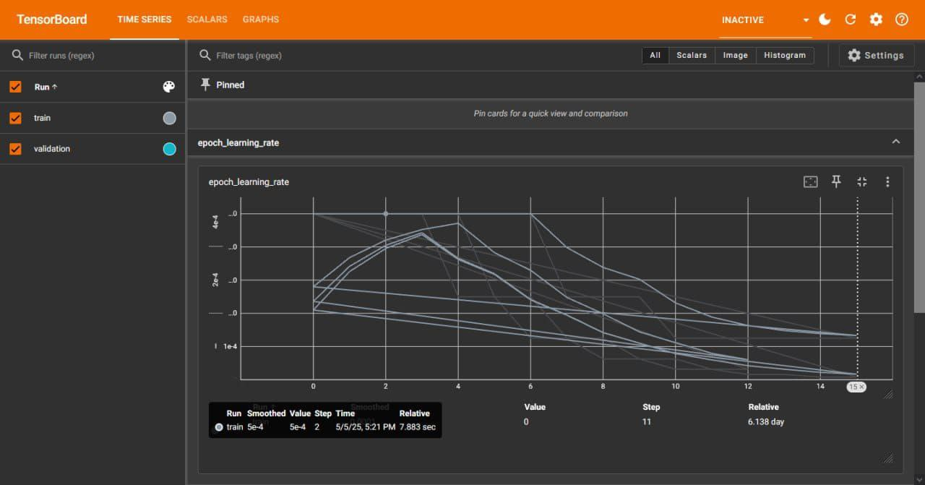

Slide 34
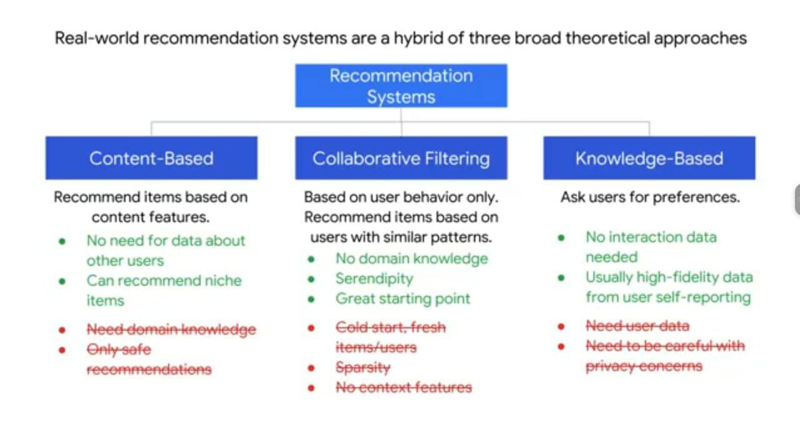

Slide 35
DEPLOYMENT
07

Slide 36
Content-Based Recommendation Model
Deployment Overview:
Gradio Interface:
The system was deployed with a Gradio interface where users can input a user ID for recommendations or select a movie to find similar movies
TMDB API Integration:
Movie posters and details are dynamically fetched from the TMDB API for a richer user experience.

Slide 37
Neural Collaborative Filtering (NCF) Model
Deployment Overview:
Gradio Interface:
A web-based interface was built to allow users to input their user ID and receive personalized movie recommendations.
TMDB API Integration:
Using the TMDB API, movie posters and additional information (e.g., rating) are displayed alongside the recommendations.

Slide 38
Hybrid Recommendation Model
Deployment Overview:
Gradio Interface:
The system was deployed with an interactive web interface using Gradio.
User Input :
Users can input their user ID to receive personalized recommendations or select a movie to find similar suggestions.

Slide 39
Hybrid Recommendation Model
Deployment Overview:
Integration with TMDB API:
Movie details such as posters, genres, and ratings are fetched dynamically using the TMDB API.
Workflow:
Upon entering the user ID, recommendations are displayed based on both Collaborative Filtering and Content-Based Filtering.
Users can also get movie suggestions based on a movie title.

Slide 40
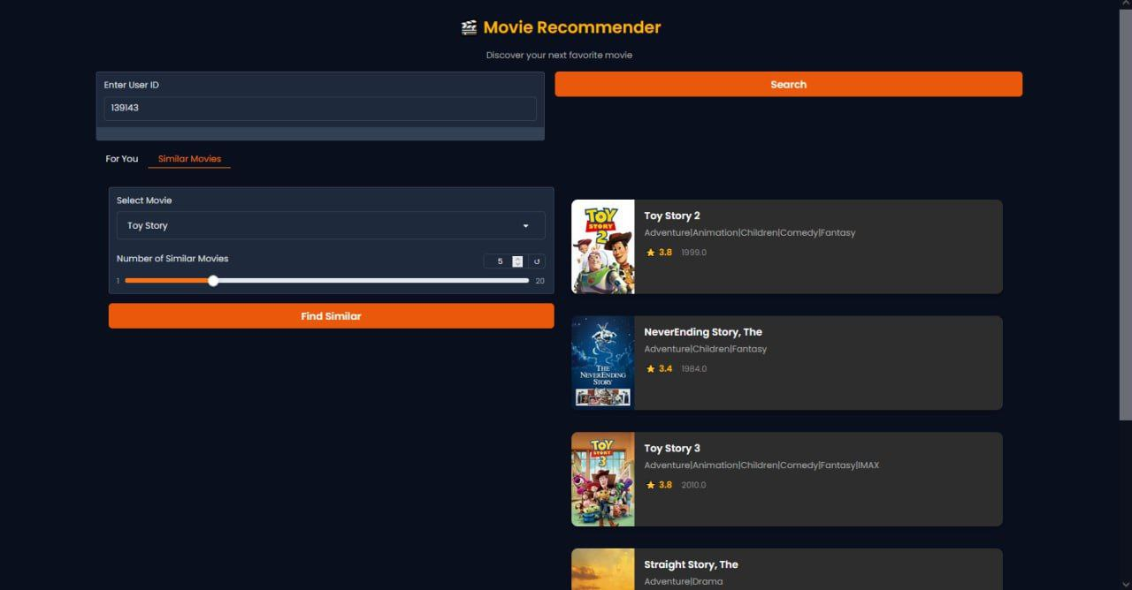

Slide 41
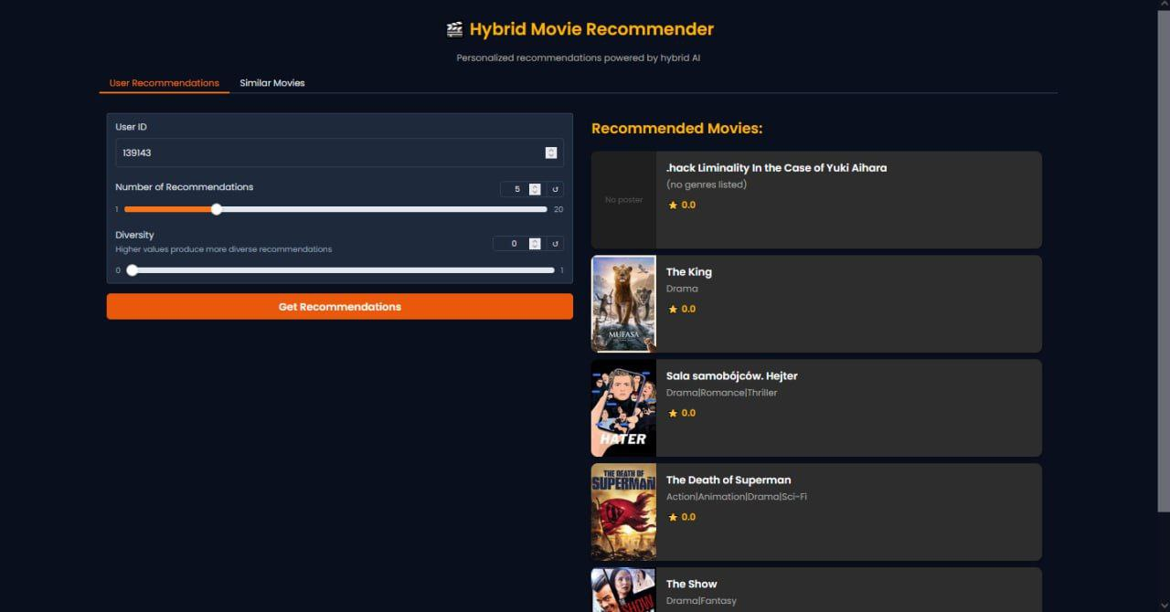

Slide 42
THANKS!

